Slide 1
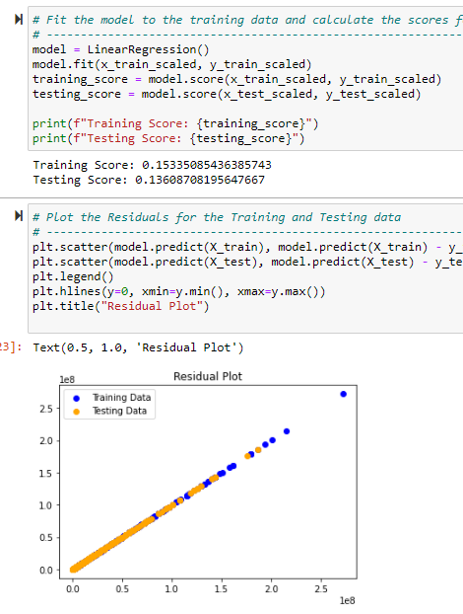
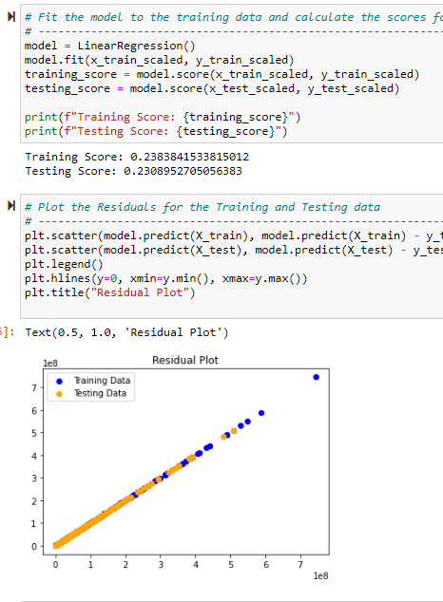
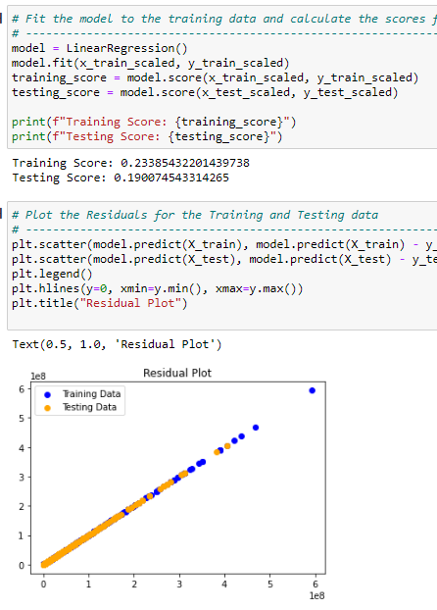
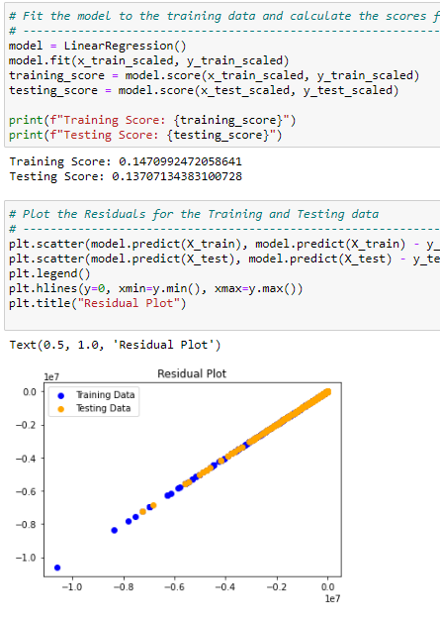
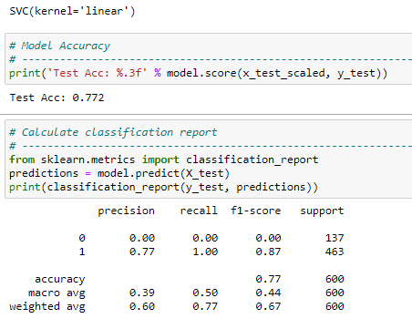
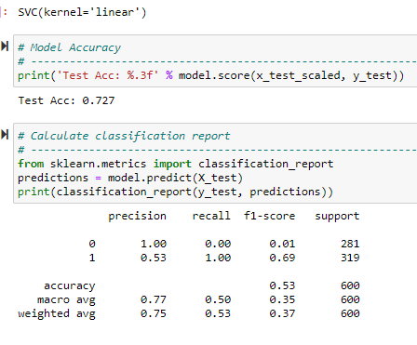
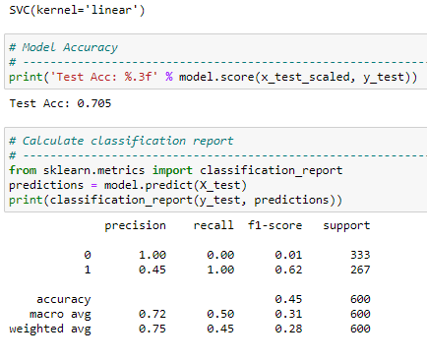
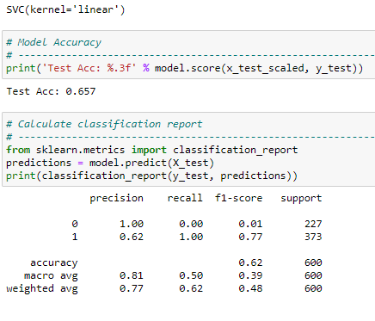
Y (Revenue)
Y (TotalVotes)
Y (Popularity2)
Y (Rating)
X Budget, Runtime, Genre and Language
model_data['average_revenue'] = np.where(model_data['revenue'] >1700000, 1, 0)
X Budget, Runtime, Genre and Language
model_data['total_votes'] = np.where(model_data['total Votes'] >263, 1, 0)
X Budget, Runtime, Genre and Language
model_data['popularity_rating'] = np.where(model_data['popularity2'] >8, 1, 0)
X Budget, Runtime, Genre and Language
model_data['average_rating'] = np.where(model_data['rating'] >6, 1, 0)
MLR Model
SVC Model

Slide 2
